Slide 1
CTF model for long reverberation Date：2022. 02. 15
Telecom Electroacoustics Audio (TEA) Lab
Presenter:
Anchi Yuan
Notes:
Hello everyone
I’m today’s presenter siang. I’m going to share some of my present work in source separation problem. My topic is comparative studies of source separation using semi-blind and blind source separation approaches.

Slide 2
outline
Multichannel model
Wiener filtering (single source)
Recursive implementation
Simulation settings
Simulation results
Future work

Slide 3
Multichannel model

Slide 4
Wiener filtering (single source)

Slide 5
Recursive implementation

Slide 6
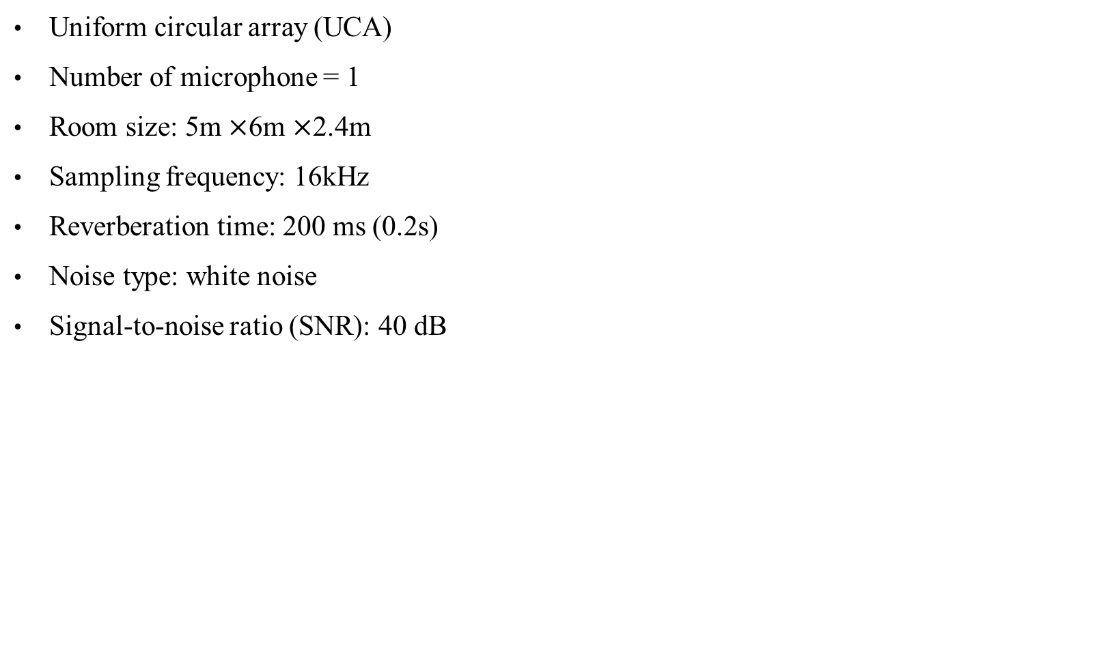
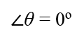
Simulation settings
Uniform circular array (UCA)
Number of microphone = 1
Room size: 5m $×$6m $×$2.4m
Sampling frequency: 16kHz
Reverberation time: 200 ms (0.2s)
Noise type: white noise
Signal-to-noise ratio (SNR): 40 dB
R = 1m
mic1
3m
(1,3)
(4,3)
$∠$θ = 0º

Slide 7
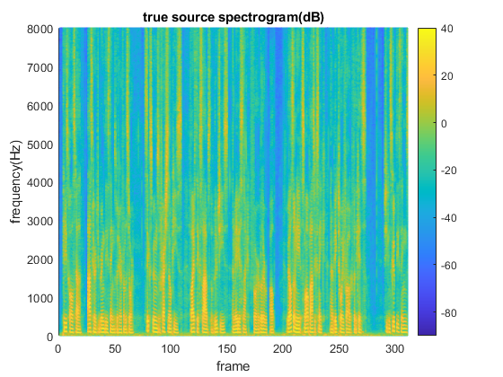
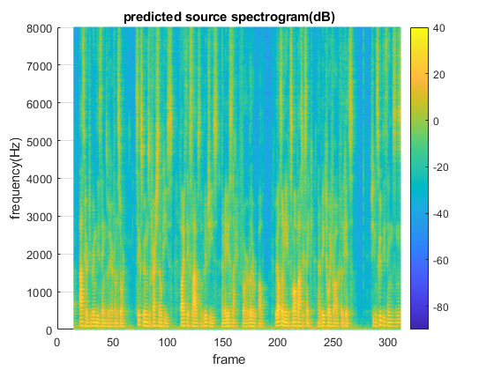
Simulation results
True source spectrogram
predicted source spectrogram

Slide 8
Future work
Debug
Recover time domain signal
Initialize with recursive ATF

Slide 9


